Slide 1
Active Directory OU Admin Training
Windows Enterprise Services

Slide 2
Agenda
Introductions
UNM Directory Services
RSAT
Organizational Units (OU)
Active Directory Groups
Naming Convention
Joining Workstations
File Services
Sharing & Security tabs
GPOs
OU Administrators Responsibilities
Troubleshooting tools
Guidelines
Support

Slide 3
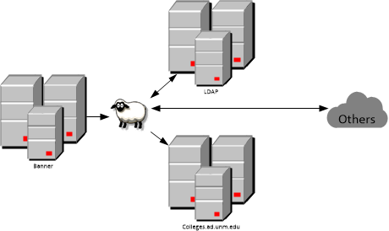
LAMB & AD
LAMB
Authoritative Source of information for AD
Process of NetID creation, org code to OU mapping, account retention
Active Directory
Microsoft’s implementation of LDAP
Empty root
Colleges and HSC domains

Slide 4
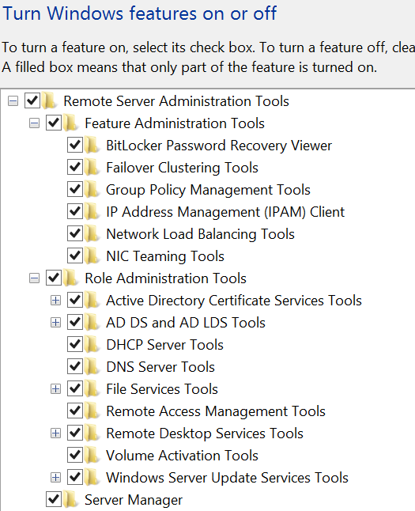
RSAT
RSAT (Remote Server Administration Tools)
allows administrators to run snap-ins and tools on a remote computer to manage features and roles
Computers includes the AD Users and (ADUC) and Group Policy Management tools
Windows 7
https://www.microsoft.com/en-us/download/details.aspx?id=7887
Windows 8
https://www.microsoft.com/en-us/download/details.aspx?id=28972

Slide 5
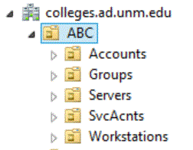
Organizational Units
Delegate responsibility to UNM departments and affiliates
OU Admins are responsible for their own OU structures
Enterprise Admins oversee entire forest
Standard Sub-OUs we create for you:
Accounts - populated by LDAP. DO NOT DISABLE OR DELETE
Groups - where you create groups
Servers – your departmental servers here
SvcAcnts – privileged application or admin accounts
Workstations - your workstations. PRESTAGE COMPUTERS BEFORE JOINING TO AD

Slide 6
AD Groups
Group Types:
Security Groups
Universal: Cross forest
Global: Between domains
Domain Local: In your domain
Distribution Groups: Not what it used to be!
Microsoft’s Best Practice - AGDLP
The order to assign user permissions to resources - Accounts, Global, Domain Local, Permissions
Role based security provisioning
User Roles correspond to a global group
Security Roles are assigned to a domain local group
Demo

Slide 7
NAMING CONVENTION
Workstations, Servers & Printers
ABC-LN00040797
ABC153WEB01
ABC153-1104-Konika284
Groups
ABC-OUAdmins-DL
ABC-OUAdmins-GG
Service Accounts
sqlABCSVC (SQL service in ABC dept)
ahABCSVC (admin acct in ABC dept)
Group Policy Objects (GPOs)
ABC-Classroom 103 File Share

Slide 8
Joining Workstations
Pre-stage all computers
Use your svc account
Demo
Join workstations to colleges.ad.unm.edu
Local vs. domain user profiles
Netdom join /d:colleges.ad.unm.edu ABC-DC8MRSJ1 /OU:OU=Workstations,OU=ABC,DC=colleges,DC=ad,DC=unm,DC=edu /ud:colleges\ahabcsvc /pd:MySecretPassword
Add-Computer –DomainName colleges.ad.unm.edu –OUPath “OU=Workstations,OU=ABC,DC=colleges,DC=ad,DC=unm,DC=edu” –Credential colleges\ahabcsvc -Restart

Slide 9
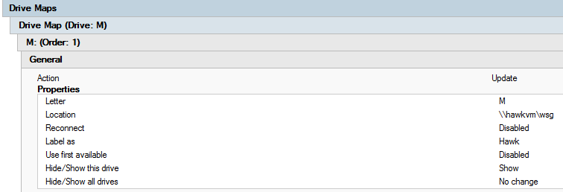
File Services
Centralized storage and backup
Mapped drives
Shared and Home directories

Slide 10
Sharing & Security Tabs
Sharing
Create a Domain Local group for your department
Grant access to that group
Security – NTFS
Full Control should only be given to OU Admins
Do not remove Domain Admins group
Combination of Modify, Read & Execute, List folder contents, Read and Write permissions may be assigned to User groups
NTFS permissions should be less permissive than Sharing permissions

Slide 11
GPOs
Group Policy Objects
Customized MMC
Default GPOs we create for you
How to request and test GPOs
Support model
Scripts vs Preferences
Loopback Processing Mode

Slide 12
OU Admins Responsibilities
Support for your end users
Managing your department’s resources
Managing permissions for resources
Securing your department’s data

Slide 13
Troubleshooting Tools
Command line tools – demo
Nslookup - queries DNS entries and ip lookup
Ping - see if a host is reachable by IP. Firewall restrictions can limit this
Telnet - verifies a port is open on a resource
Gpudate /force - will immediately apply any group policy you have put in place instead of waiting
Gpresult /r /v - will detail what group policies are applied to the workstation and user
Powershell

Slide 14
Guidelines
Please…
Do not remove Domain Admins group
Do not use your regular NetID for admin work. Always “Run as different user”.
Do not delete accounts.
Recycle Bin with 2008R2
Common Problems
Typos when pre-staging
Wired vs. wireless
AD is not down… (If it is, we already know it!)
Disabled & expired accounts
Changing group membership

Slide 15
Support
Contact IT Service Desk
https://help.unm.edu/CherwellPortal/ServiceDesk
Submit incident or service request
FastInfo
https://unmm.sharepoint.com/teams/it/platforms/wes/adoutraining/_layouts/15/start.aspx#/SitePages/Home.aspx
http://it.unm.edu/ad

Slide 16
Questions?
Thank you

